Slide 1

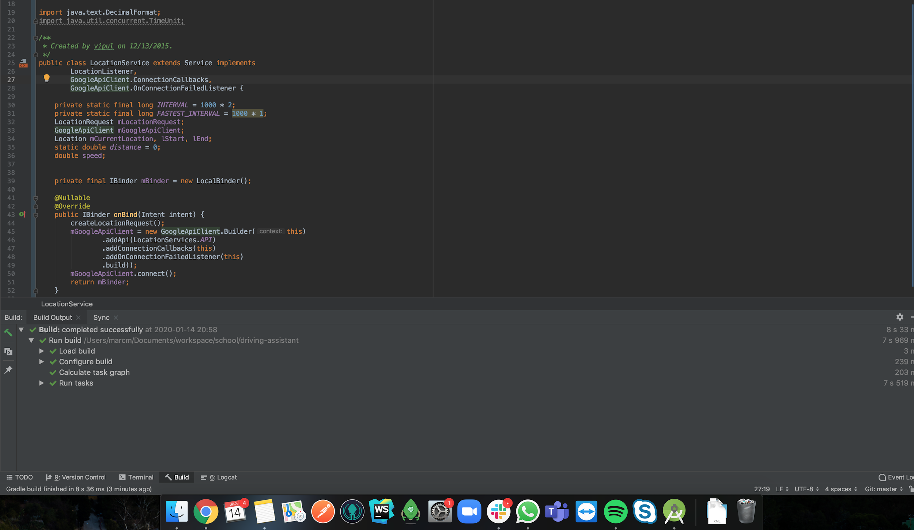

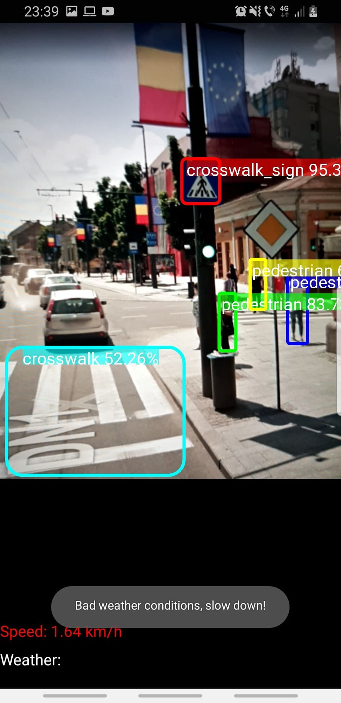
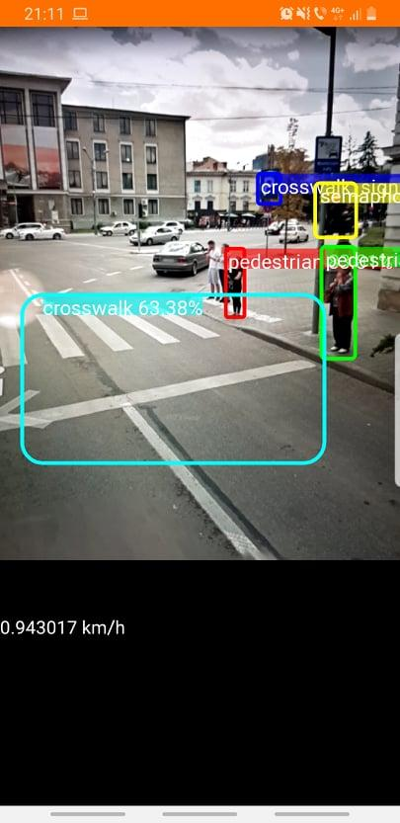
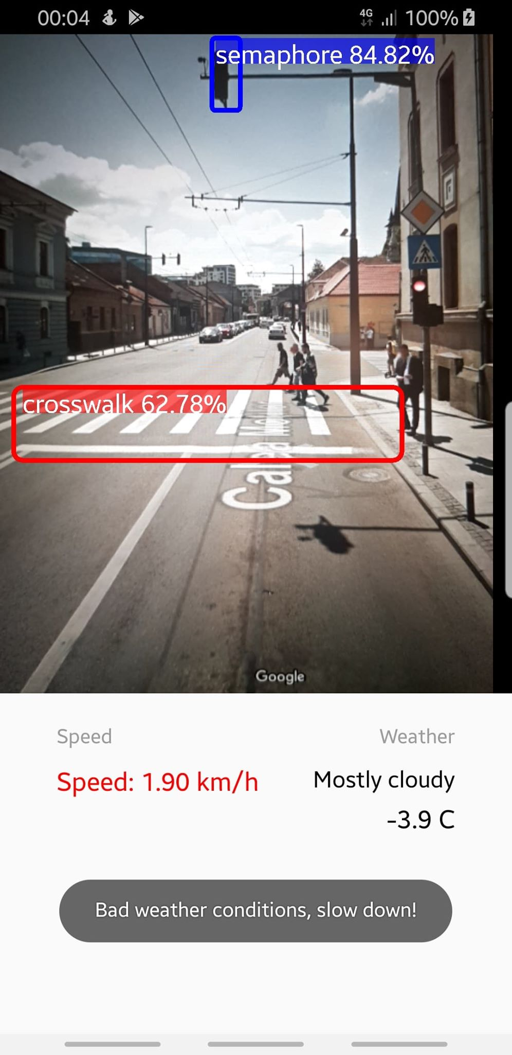
Smart Driving
Assistant
Tudor Maier
Marc Moldovan
Group 258 / 2

Slide 2
Outline
The Problem
Solution Proposal
The Approach
Application Demo
Next Steps / Future Work

Slide 3
The Problem

Slide 4
Problem statement
Drivers with vision problems and long-haul drivers
Less attention for road signs and obstacles
Exceeding safety limits under bad weather conditions

Slide 5
What customers do today
Luxurious cars or sophisticated solutions
Nowadays, premium cars offer a smart driving assistant but for a huge price.
On the other hand, useful data is stored in the car’s motherboard, but really difficult to make it human friendly.

Slide 6
Solution Proposal

Slide 7
Solution description
Mobile application that will improve the driving experience by assisting the user both visually and to adapt the speed according to the weather conditions
Object detection of crosswalks, crosswalk signs, traffic lights, pedestrians
Display the current location weather
Speedometer with speed limit notifications

Slide 8
Why it’s better than existing solutions
The main purpose of this application is to provide a more accessible and cheaper solution that works with every car and most of the Android smartphones.

Slide 9
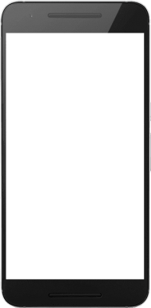
Main Application Layout

Slide 10
The Approach

Slide 11

Get the model
01
Pre-trained models
Tensorflow provides several pre-trained model which are already optimized (MobilenetV2, Faster R-CNN ...)
The benefit of transfer learning is
that training can be much quicker and the required data is much less.
VS
Custom model
Build your own Neural Network
Customize your pre-processing layers, intermediary layers, neurons, output layer and much more to suit your needs.

Slide 12
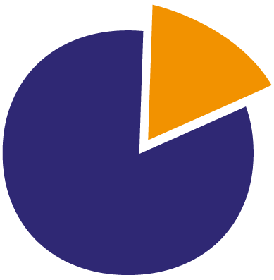

Prepare your own dataset
02
Gather images & manipulation
Recommended number of images per class 300 - 500
Resize images for faster training
LabelImg is a great tool for labeling images (open-source from GitHub)
20%
Test images
80%
Train images

Slide 13

Run the model with the new data
03
Tensorflow provides a framework for Python in order to train your models.
Keep training the model with several input params (training steps, evaluation steps, etc…) in order to obtain the most efficient model.
Training can take from 30 mins up to 24 hours depending on your GPU/CPU, dataset and input params.

Slide 14

Get model’s lite version with TFLite
04
Convert the trained graph to Tensorflow Lite format using
TOCO (TensorFlow Lite Optimizing
Converter)
Easily converted to TFLite using Python scripts.
TFLite format can be interpreted by Android’s Tensorflow API.

Slide 15


Run the model on Android
05
TensorFlow Lite provides Object detection API for easily integrating your trained model into a Mobile app.
Consume the TensorFlow SDK in order to customize your output results.

Slide 16
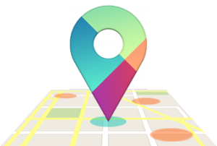
Integrate Google Location Service
06
Get Google Location’s SDK
Get Google API key
Retain current location and future locations in order to compute your current speed.
Use current speed in order to send alerts to the user.

Slide 17

Accuweather API
Integration
07
Get AccuWeather API key
Integrate Retrofit for HTTP calls to the API in order to obtain the current weather conditions
Use current weather conditions in order to alert the user for safety reasons

Slide 18
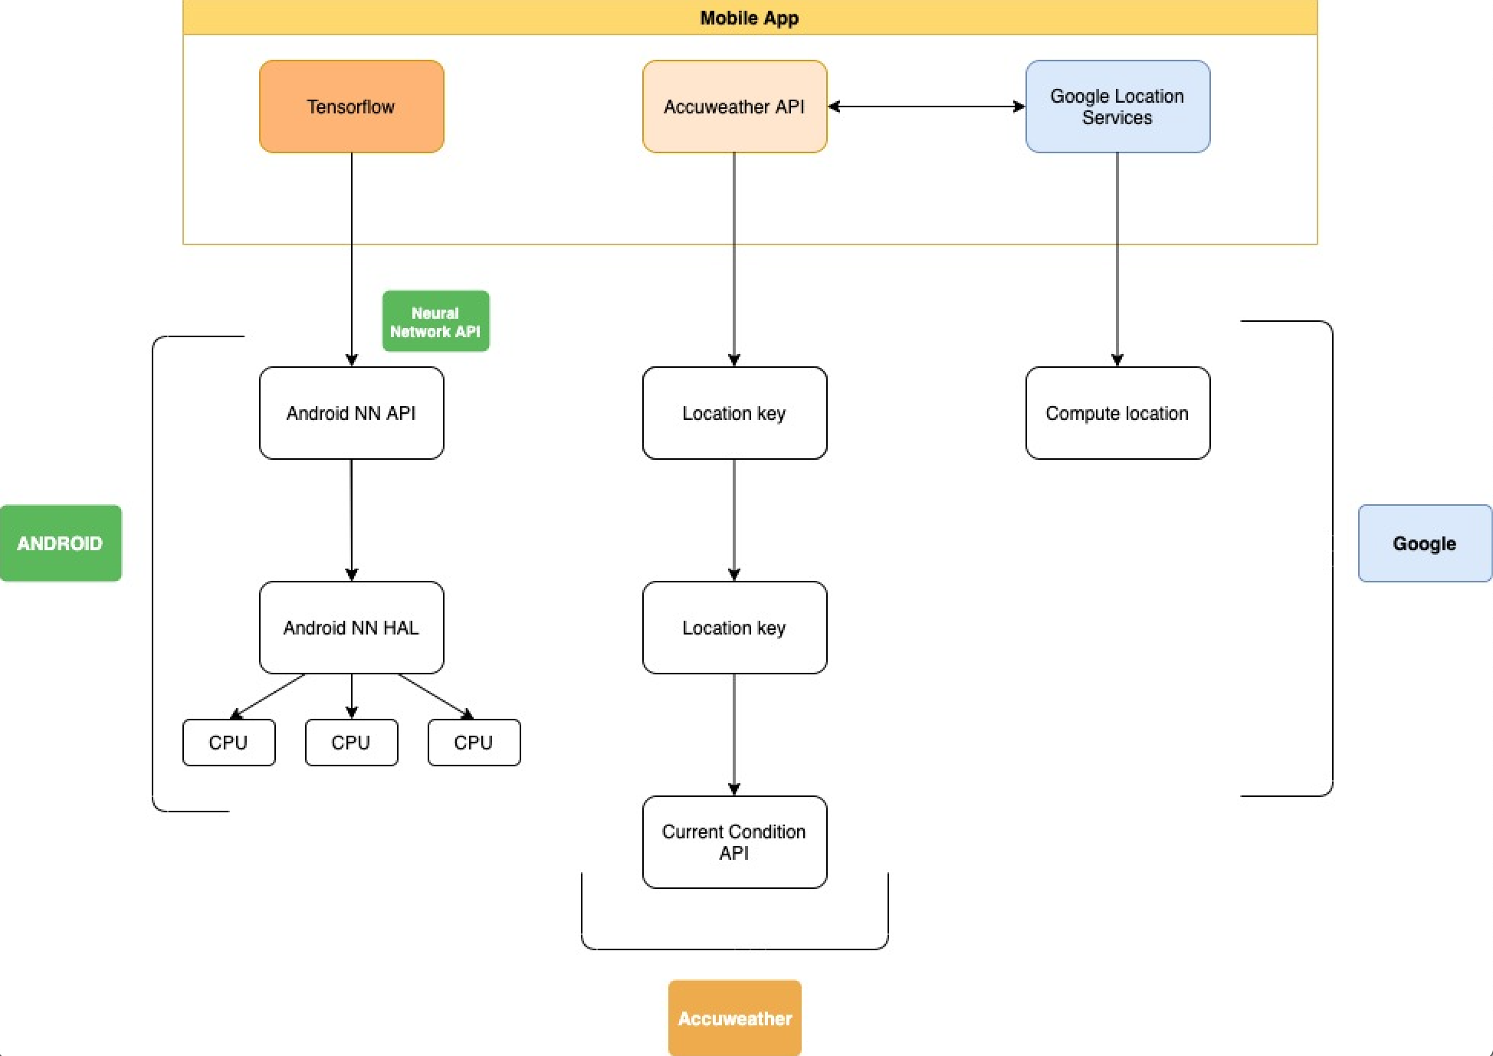
Information architecture

Slide 19
Application Demo

Slide 20
Next Steps / Future Work

Slide 21
What next?
Battery usage improvement
Add different object to be detected
IOS implementation
Responsive UI

Slide 22


Thank you

Slide 23
Questions?

